Slide 1
Deadlock
Operating Systems

Slide 2
Deadlock
A set of processes is in a deadlocked state if every process in the set is waiting for an event that can be caused only by another process in the set.
Example:
Two process : P1, P2
Two resource: R1, R2
P1 is holding R1 and waiting for R2
P2 is holding R2 and waiting for R1
Holding
R1
Waiting for
P1
P2
Waiting for
R2
Holding

Slide 3
System Model
A system contains finite number of resources
These resources are distributed among competing processes
Examples: CPU cycle, File, I/O devices ( printer, DVD drive) etc.
Each resource type may have identical number of instances
A process may request as many resource as it requires.
But, it should not exceed the total number of available resources of the system
A process may utilize a resource only in the following sequence
Request: requests the resource
Use: operate on the resource
Release: releases the resource

Slide 4
Necessary Conditions for Deadlock
A deadlock situation can arise if the following four conditions hold simultaneously in a system -
Mutual exclusion
Hold and wait
No preemption
Circular wait
If one of them is not present in a system, no deadlock will arise

Slide 5

Mutual Exclusion
At least one resource must be held in a nonsharable mode; that is, only one process at a time can use the resource
R1
R1
R1
P1
P2
P1
P2
P1
P2

Slide 6
Hold and Wait
A process must be holding at least one resource, and waiting to acquire additional resources that are currently being held by other processes.
R1
P1
P2
R2

Slide 7

No Preemption
a resource can be released only voluntarily by the process holding it, after that process has completed its task.

Slide 8
Circular Wait
A set {P₀, P₁, ..., P_{n}} of waiting processes must exist such that
P0 is waiting for a resource held by P₁,
P₁ is waiting for a resource held by P₂, ..., P_{n−1} is waiting for a resource held by P_{n}, and
P_{n} is waiting for a resource held by P₀
R0
P_{n}
P0
R_{n}
R1
P1

Slide 9
Resource Allocation Graph

Slide 10




Resource Allocation Graph
A set of vertices V and a set of edges E.
V is partitioned into two types:
P = {P₁, P₂, …, P_{n}}, the set consisting of all the processes in the system.
R = {R₁, R₂, …, R_{m}}, the set consisting of all resource types in the system.
Request edge: directed edge from a process to a resource
P₁ → R₂
Assignment edge: directed edge from a resource to a process
R₁ → P₂
Process
Resource Type with 4 instances
P_{i} requests instance of R_{j}
P_{i} is holding an instance of R_{j}

Slide 11
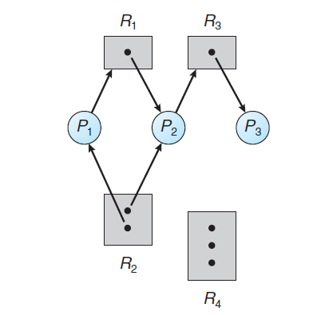
Example of Resource Allocation Graph
P ={P1, P2, P3}
R ={R1, R2, R3, R4}
E ={P1 → R1, P2 → R3, R1 → P2, R2 → P2, R2 → P1, R3 → P3}

Slide 12
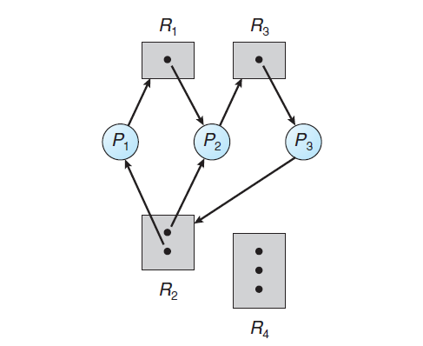
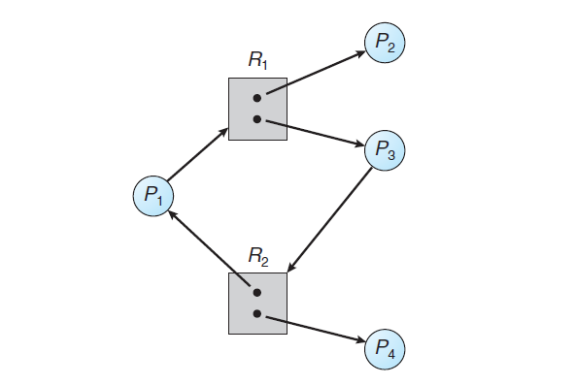
Resource Allocation Graph (Deadlock)
Cycle:
Possibility of Deadlock.
No Cycle:
No Deadlock.
Cycle 1: P1 → R1 → P2 → R3 → P3 → R2 → P1
Cycle 2: P2 → R3 → P3 → R2 → P2
Cycle: P1 → R1 → P3 → R2 → P1
No Deadlock!
Deadlock!

Slide 13
Methods for Handling Deadlocks
Prevention:
Ensure that the system will never enter a deadlock state
Avoidance:
request for any resource will be granted if the resulting state of the system doesn't cause deadlock
Detection and recovery:
Allow the system to enter a deadlock state and then recover

Slide 14
Deadlock Prevention
Operating Systems

Slide 15
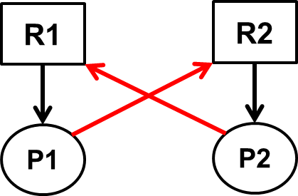
Deadlock Prevention
Ensure that at least one of the necessary conditions for deadlock cannot hold in the system.
Mutual Exclusion:
Mutual exclusion condition must hold
At least one resource must be non-sharable
Sharable resources do not require mutually exclusive access (example: Read only files)
Hold and Wait:
Guarantee that when a process requests a resource, it does not hold any other resources.
Protocol 1: Request and allocate all its resources before execution.
Protocol 2: Allow process to request resources only when the process has none.
Disadvantages:
Low utilization of resources
Starvation

Slide 16
Deadlock Prevention
No Preemption:
If a process is holding some resources and requesting for another resource, which is held by another process, then this process needs to wait, and the resources held by it will be preempted or released.
Preempted resources are added to the list of resources for which the process is waiting
Process will be restarted only when it can regain its old resources, as well as the new ones that it is requesting.
Circular Wait:
Impose a total ordering of all resource types
Each process requests resources in an increasing order of enumeration
R = {R₁, R₂, ..., R_{m}} and we assign unique number to each of the resource type.
For example, F(R₁) = 1, F(R₂) = 3, F(R₃) = 5.
A process can initially request any number of instances of a resource type, R_{i}
After that, the process can request instances of resource type R_{j} if and only if F(R_{j} ) > F(R_{i} ).
A process requesting an instance of resource type R_{j} must have released any resources R_{i} such that F(R_{i} ) ≥ F(R_{j} )
R1
P1
P2
R2

Slide 17
Deadlock Avoidance
Operating Systems

Slide 18
Deadlock Avoidance
System has a priori information, such as, maximum number of resources of each type that every process need
Based on these information construct an algorithm that ensures that the system will never enter a deadlocked state
Dynamically examines the resource-allocation state to ensure that a circular-wait condition can never exist
Resource-allocation state: number of available and allocated resources, and the maximum demands of the processes.

Slide 19
Safe State
A system is in safe state if it can allocate resources to each process (up to its maximum) in some order and still avoid a deadlock.
Safe state = there exists a safe sequence
A sequence <P₁, P₂, …, P_{n}> is safe if, for each P_{i}, the resources that P_{i} can still request, can be satisfied by (currently available resources + resources held by all the P_{j}, with j<i )
If P_{i} resource needs are not immediately available, then P_{i} can wait until all P_{j} have finished.
When P_{j} is finished, P_{i} can obtain needed resources, execute, return allocated resources, and terminate.
When P_{i} terminates, P_{i+1} can obtain its needed resources, and so on.

Slide 20
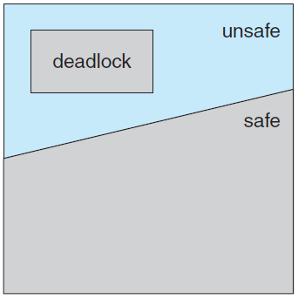
Safe State, Unsafe State & Deadlock
Safe State => No Deadlock!
Unsafe State => Possibility of Deadlock!
To avoid deadlock, always ensure that system is in safe state.

Slide 21
Resource-Allocation-Graph Algorithm
(Deadlock Avoidance Algorithm)
R1
Claim Edge
Used when the system has only one instance of each resource type.
Request Edge and Assignment Edges exist here similar to Resource allocation graph
Claim Edge: claim edge P_{i} → R_{j} indicates that process P_{i} may request resource R_{j} at some time in the future
When process P_{i} requests resource R_{j} , the claim edge P_{i} → R_{j} is converted to a request edge.
When a resource R_{j} is released by P_{i} , the assignment edge R_{j} → P_{i} is reconverted to a claim edge P_{i} → R_{j}
Resources must be claimed a priori in the system. i.e. before process P_{i} starts executing, all its claim edges must appear in the graph
P1
Requesting for a resource
Resource is Released
R1
Request Edge
P1
R1
Assignment
Edge
Resource is assigned to the process
P1

Slide 22
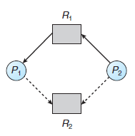
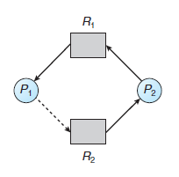
Resource-Allocation-Graph Algorithm
(Deadlock Avoidance Algorithm)
Assigning the resource to the requesting process
Cycle Detected !!!
Resource-allocation graph for deadlock avoidance
An unsafe state in a resource-allocation graph

Slide 23
Bankers Algorithm
Operating Systems

Slide 24
Banker’s Algorithm (Deadlock Avoidance Algorithm)
Multiple instances of each resource type.
Each process must a priori claim maximum use.
When a process requests a resource it may have to wait.
When a process gets all its resources it must return them in a finite amount of time.

Slide 25
Data Structures for the Banker’s Algorithm
Need the following data structures, where n is the number of processes in the system and m is the number of resource types.
Available: Array of length m, indicates the number of available resources of each type.
Max: n by m matrix, defines maximum demand of each process for each type.
Allocation: n by m matrix, defines number of assigned resources to each process for each type.
Need: n by m matrix, defines number of remaining resources of each type needed by each process.
Need [i,j] = Max[i,j] – Allocation [i,j]

Slide 26
Banker’s Safety Algorithm
Algorithm for finding out whether or not a system is in a safe state
Let Work and Finish be vectors of length m and n, respectively. Initialize Work = Available and Finish[i] = false for i = 0, 1, ..., n − 1.
Find an index i such that both of the following meets, Finish[i] == false Need_{i} ≤ Work if no such i exists, go to step 4.
Work =Work + Allocation_{i} Finish[i] = true Go to step 2.
If Finish[i] == true for all i, then the system is in a safe state.

Slide 27
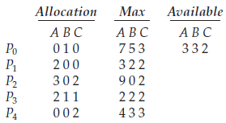
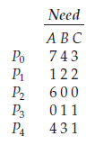
Banker’s Algorithm Example
5 processes P0 through P4;
3 resource types A (10 instances), B (5 instances), and C (7 instances)
at time T0, the following snapshot of the system:
true
0
1
2
3
4
finish:
f | f | f | f | f
work:
3 | 3 | 2
false
if finish[i] == false & Need_{i} ≤ Work then
Work = Work + Allocation_{i} Finish[i] = true
else
wait
Start with i = 0

Slide 28
Banker’s Algorithm Example
5 processes P0 through P4;
3 resource types A (10 instances), B (5 instances), and C (7 instances)
at time T0, the following snapshot of the system:
true
0
1
2
3
4
finish:
f | f | f | f | f
work:
3 | 3 | 2
true
if finish[i] == false & Need_{i} ≤ Work then
Work = Work + Allocation_{i} Finish[i] = true
else
wait
i = 1
< P₁>

Slide 29
Banker’s Algorithm Example
5 processes P0 through P4;
3 resource types A (10 instances), B (5 instances), and C (7 instances)
at time T0, the following snapshot of the system:
true
0
1
2
3
4
finish:
f | t | f | f | f
work:
5 | 3 | 2
false
if finish[i] == false & Need_{i} ≤ Work then
Work = Work + Allocation_{i} Finish[i] = true
else
wait
i = 2
< P₁>

Slide 30
Banker’s Algorithm Example
5 processes P0 through P4;
3 resource types A (10 instances), B (5 instances), and C (7 instances)
at time T0, the following snapshot of the system:
true
0
1
2
3
4
finish:
f | t | f | f | f
work:
5 | 3 | 2
true
if finish[i] == false & Need_{i} ≤ Work then
Work = Work + Allocation_{i} Finish[i] = true
else
wait
i = 3
< P₁, P₃>

Slide 31
Banker’s Algorithm Example
5 processes P0 through P4;
3 resource types A (10 instances), B (5 instances), and C (7 instances)
at time T0, the following snapshot of the system:
true
0
1
2
3
4
finish:
f | t | f | f | f
work:
7 | 4 | 3
true
if finish[i] == false & Need_{i} ≤ Work then
Work = Work + Allocation_{i} Finish[i] = true
else
wait
i = 4
< P₁, P₃ , P₄ >

Slide 32
Banker’s Algorithm Example
5 processes P0 through P4;
3 resource types A (10 instances), B (5 instances), and C (7 instances)
at time T0, the following snapshot of the system:
true
0
1
2
3
4
finish:
f | t | f | t | t
work:
7 | 4 | 5
true
if finish[i] == false & Need_{i} ≤ Work then
Work = Work + Allocation_{i} Finish[i] = true
else
wait
i = 0
< P₁, P₃, P₄ , P₀ >

Slide 33
Banker’s Algorithm Example
5 processes P0 through P4;
3 resource types A (10 instances), B (5 instances), and C (7 instances)
at time T0, the following snapshot of the system:
true
0
1
2
3
4
finish:
t | t | f | t | t
work:
7 | 5 | 5
true
if finish[i] == false & Need_{i} ≤ Work then
Work = Work + Allocation_{i} Finish[i] = true
else
wait
i = 2
< P₁, P₃, P₄, P₀, P₂>

Slide 34
Banker’s Algorithm Example
5 processes P0 through P4;
3 resource types A (10 instances), B (5 instances), and C (7 instances)
at time T0, the following snapshot of the system:
0
1
2
3
4
finish:
t | t | t | t | t
work:
10 | 5 | 7
if finish[i] == false & Need_{i} ≤ Work then
Work = Work + Allocation_{i} Finish[i] = true
else
wait
The system is in a safe state since the sequence < P₁, P₃, P₄, P₀, P₂> satisfies safety criteria

Slide 35
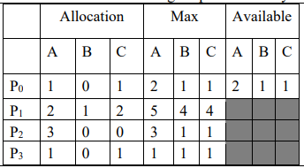
Practice

Slide 36
Resource-Request Algorithm for Process P_{i}
Request = request vector for process P_{i}
If Request[i][j] = k then process P_{i} wants k instances of resource type R_{j}
1. If Request_{i} <= Need_{i} go to step 2. Otherwise, raise error condition, since process has exceeded its maximum claim.
2. If Request_{i} <= Available_{i} , go to step 3. Otherwise P_{i} must wait, since resources are not available.
3. Pretend to allocate requested resources to P_{i} by modifying the state as follows:
Available = Available - Request_{i};
Allocation_{i} = Allocation_{i} + Request_{i};
Need_{i} = Need_{i} – Request_{i};
4. Check Bankers Safety Algorithm, if this new state is safe.
If safe the resources are allocated to P_{i}.
If unsafe P_{i} must wait, and the old resource-allocation state is restored

Slide 37
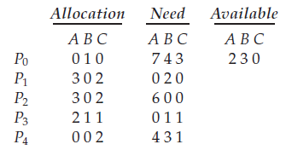
What if P₁ Request (1,0,2) more ?
To decide whether this request can be immediately granted,
we first check that Request₁ ≤ Need₁ — that is, (1,0,2) ≤ (1,2,2)? => TRUE
Then we check that Request₁ ≤ Available — that is, (1,0,2) ≤ (3,3,2)? => TRUE
If both is true,
Available = (3,3,2) – (1,0,2) = (2,3,0)
Allocation₁ = (2,0,0) + (1,0,2) = (3,0,2)
Need₁ = (1,2,2) – (1,0,2) = (0,2,0)
So, we arrive at the following new state
Is the system in safe state?
Yes. Because we find a safe sequence: <P₁, P₃, P₄, P₀, P₂>.
Grant the request of P₁.
What about request of (3 3 0) resources for P4?
What about request of (0 2 0) resources for P0?

Slide 38


